Slide 1
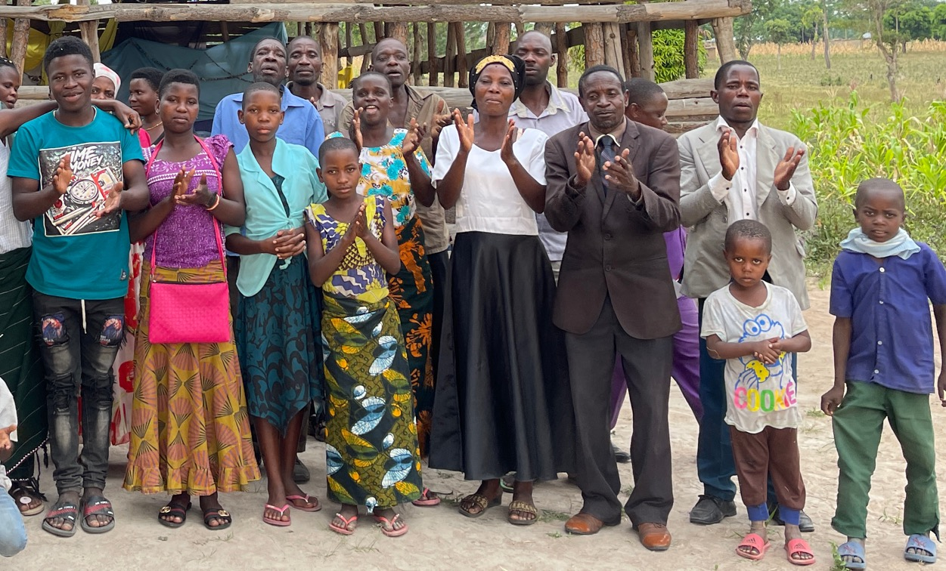



A Call to Collaborate

Slide 2

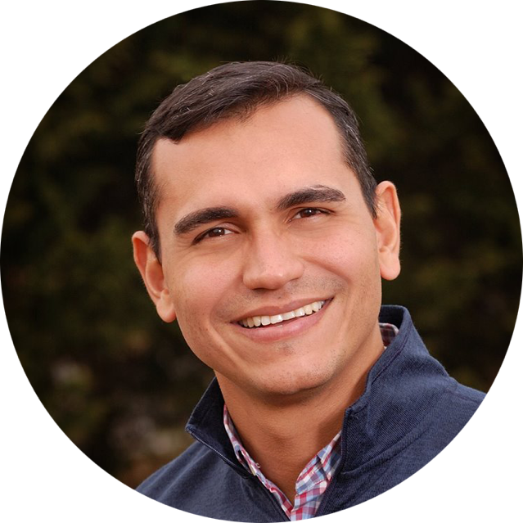
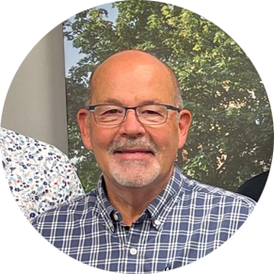


John Wagenveld, Cruz Mario Paniagua, Ron Anderson
Global Catalysts for Church Planting

Slide 3
Our Purpose
The Lausanne Church Planting Issue Network is an open,
neutral, non-transactional network that is uniquely
positioned to connect a wide spectrum of influencers
and ideas around the theme of Saturation Church
Planting. It seeks to act as a catalyst to aid the global
church to develop a clear path for the establishing of
National Saturation Church Planting processes.

Slide 4
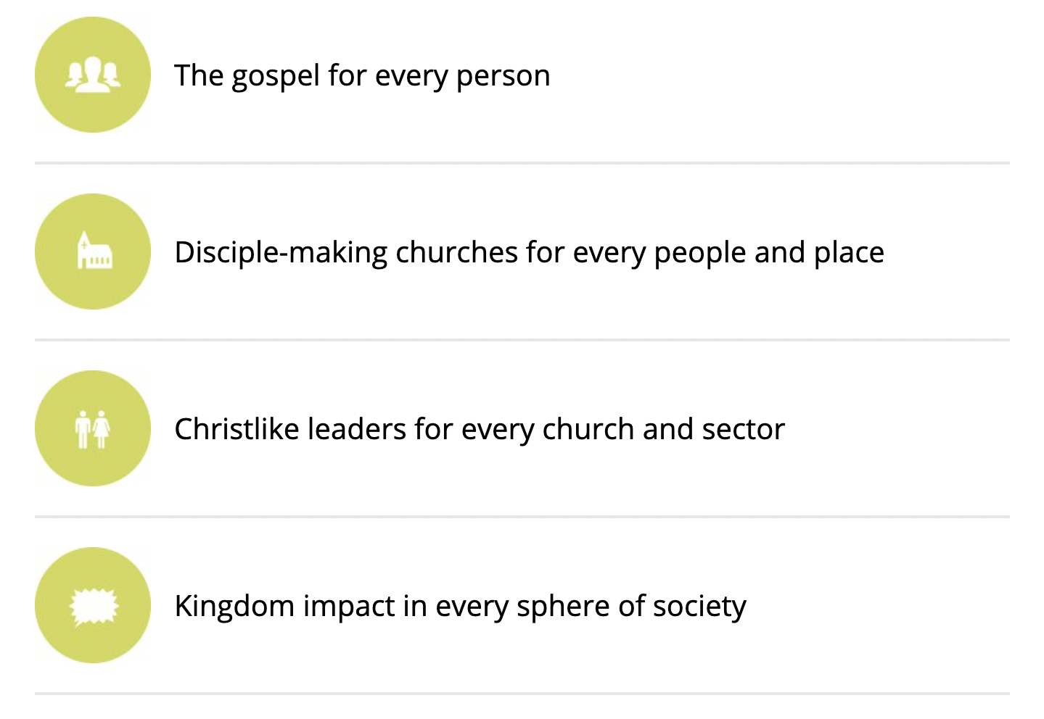

Saturation =
Lausanne’s
Vision Statement

Slide 6
Identify catalysts-champions at a national level and for each continent.
Engage champions in coaching-mentoring relationships.

Slide 7
Set up working tables or encourage existing ones to coordinate and collaborate for Saturation Church Planting at a national level.

Slide 8
Create and collect white papers, books, blogs and videos related to Church Planting. Share research, statistics and best practices so as to become known as
a trustworthy source for missiologically-sound Church Planting content.
Catalog organizations involved in Church Planting work nation
by nation.

Slide 9




View our website and Church Planting White Paper

Slide 11








You are invited to

Slide 12

The
Empty Chair
Welcome!
There is room for more networks to join!

Slide 13

Help be the answer to this core question:
What will it take to saturate our nation with the gospel through church multiplication?

Slide 14
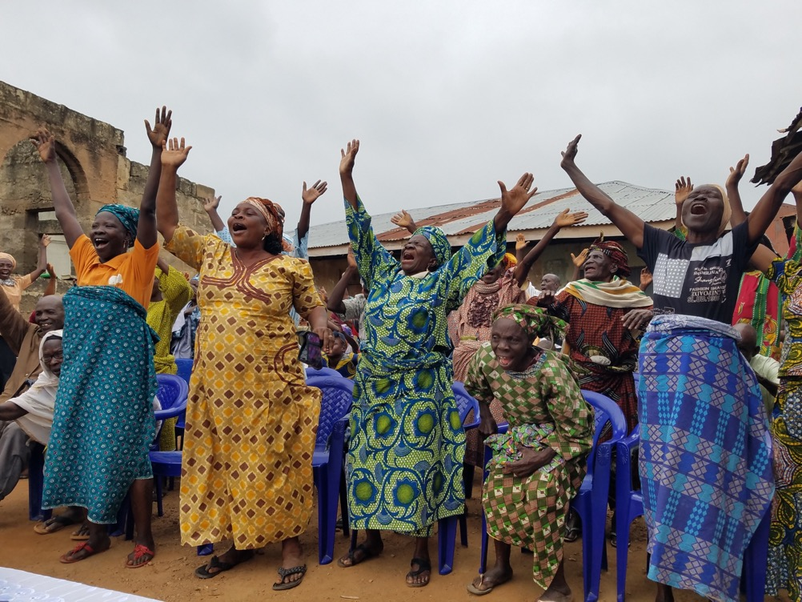

What?
Collaborate to Saturate is
An invitation to collaborate to saturate the nations with disciple-making churches.
In obedience to the Great Commission and in the spirit of Jesus’ prayer of
John 17 we collaborate to saturate
every linguistic, ethnic, geographic and social space of our nation with churches that multiply disciples.

Slide 15
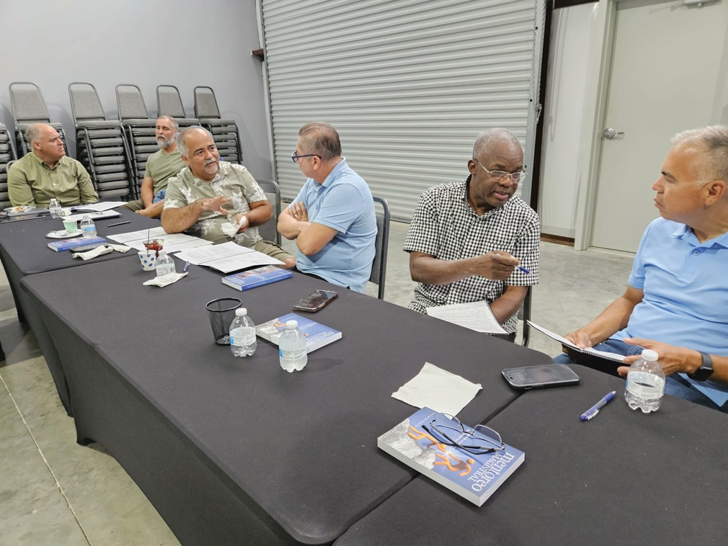
Why?
We do this to participate in
the triune God’s redemptive mission in the world.
INVITATION
Collaborate to Saturate invites you
to participate in a collaborative conversation or roundtable near you.
What is a collaborative roundtable? Here is an example….

Slide 16
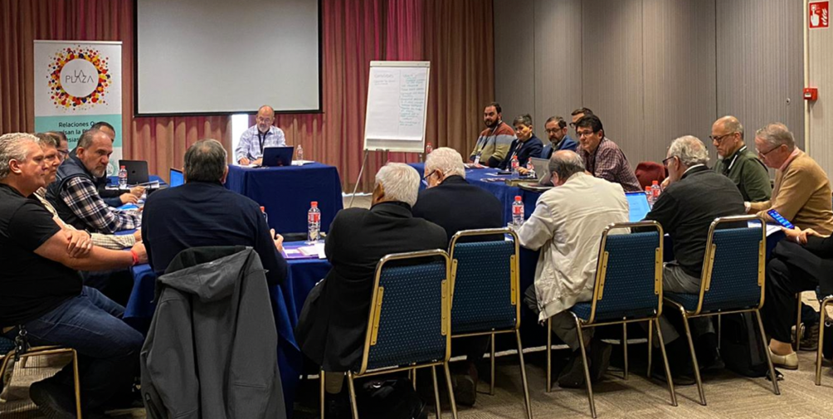




A collaborative roundtable involves…
Relationships that propel
the planting of churches
A team of leaders comes together to coordinate the efforts of saturating a country with multiplying churches.
Influencers gather to pray and strategize about the multiplication of churches and disciples.
Leaders representing as many church groups and organizations as possible are included.
La Plaza leaders coming together in Spain to discuss the advance of the Gospel and how to saturate the country with disciple making churches.

Slide 17
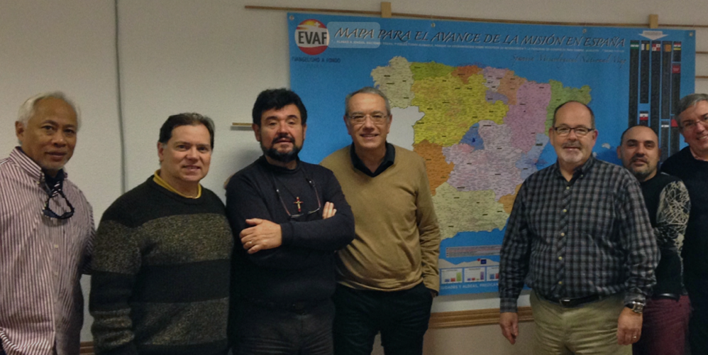


A collaborative roundtable involves…
Information that guides
decision making
Where are the places on the map where more churches are needed?
Where are the unreached people groups?
What kind of people are more receptive?
Where are more efforts needed?
How can information be shared, as appropriate, taking seriously the local context?

Slide 18
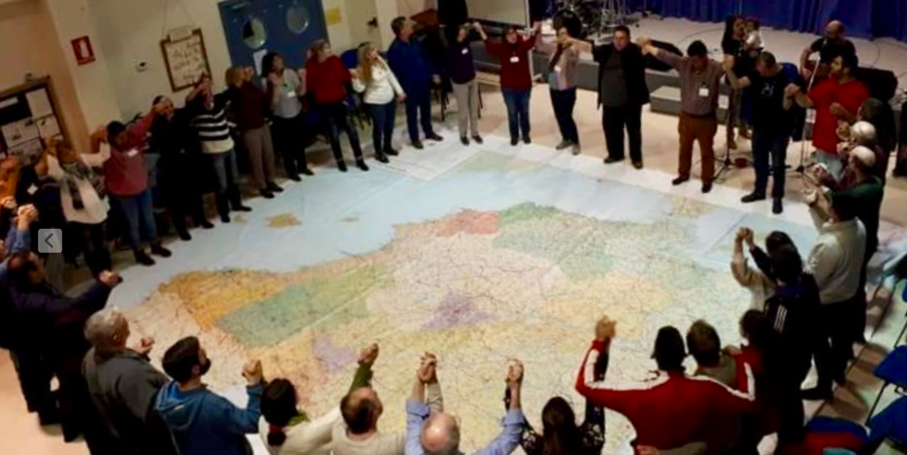

A collaborative roundtable involves…
Looking at the whole
nation together
Gatherings are organized as needed to pray, share ideas, set goals and evaluate progress.
A spirit of unity in the mission pervades the gathering and leaders encourage one another respecting the different approaches and perspectives on the mission.

Slide 19
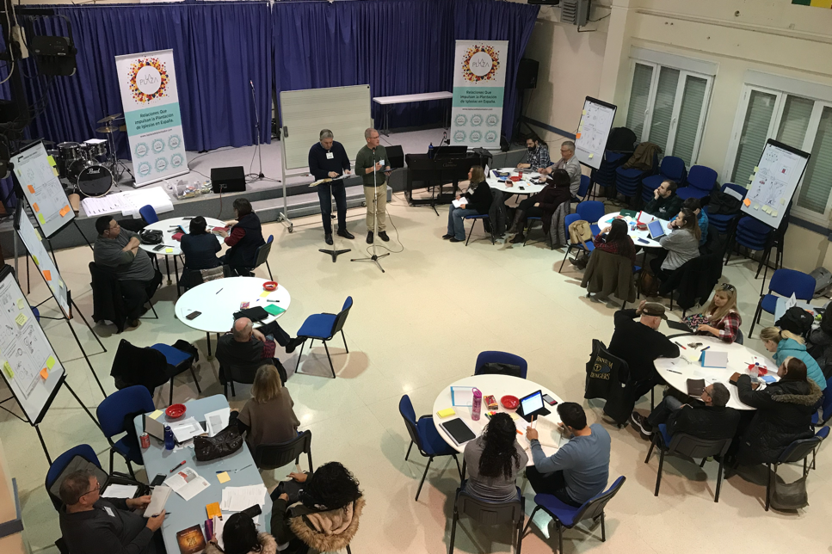

A collaborative roundtable involves…
A place for every system
that promotes saturation
Organizations that provide systems, tools, processes, materials, mentoring, coaching
and training are invited to collaborate in the implementation of the plans to saturate the
nation with multiplying churches and missional communities. The spirit of Collaborate to Saturate is inclusive, with an emphasis on grassroots collaboration and action.

Slide 20
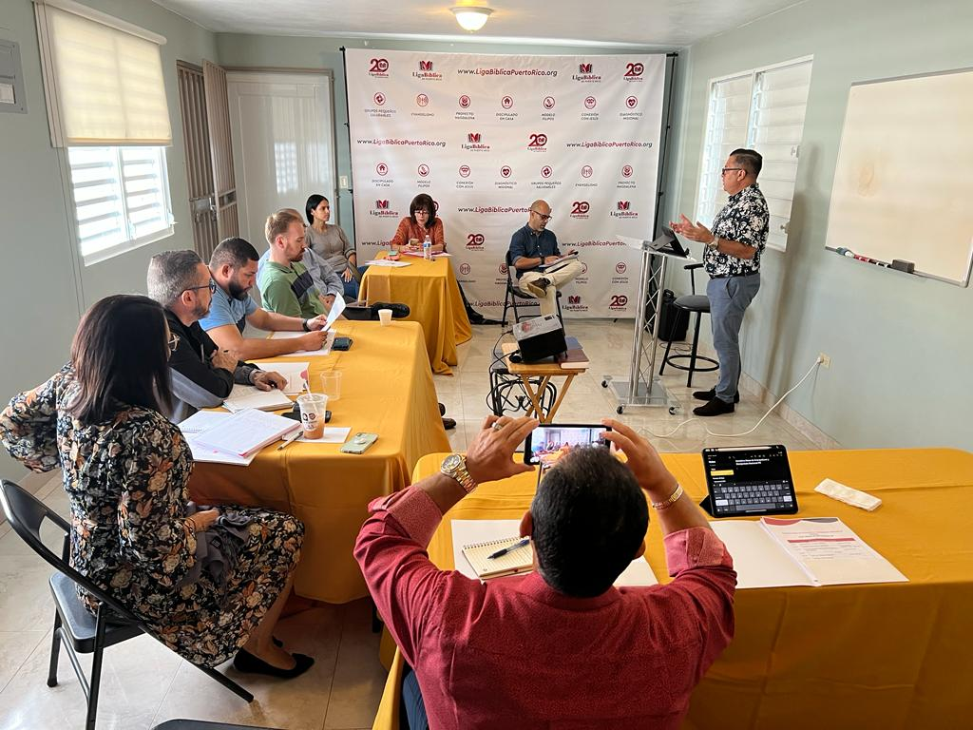
Working Table
in Puerto Rico

Slide 21
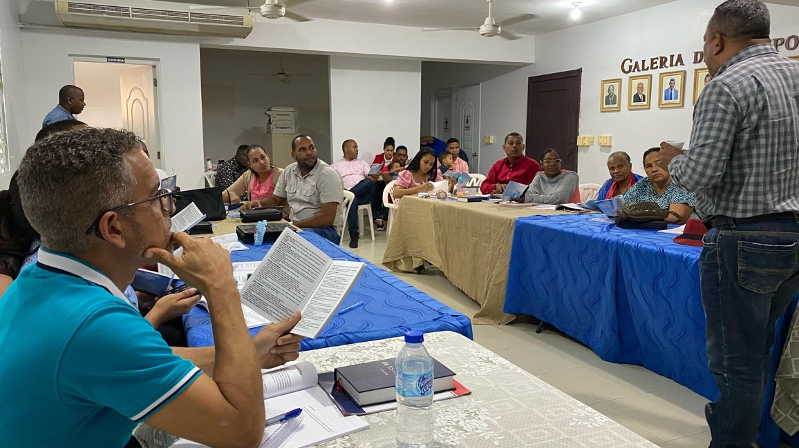
Working Table in Dominican Republic

Slide 22















Another example:
Dominican Republic: many denominations and networks – One Goal!

Slide 23
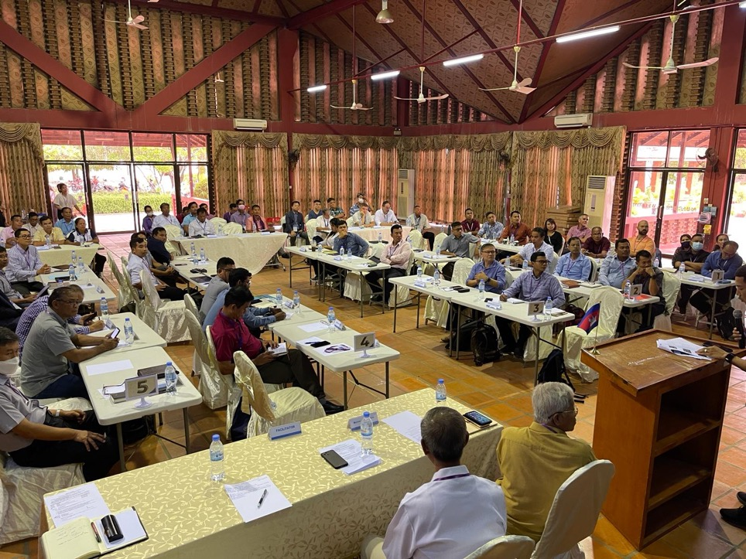
Other examples
Cambodia
2nd Roundtable Gathering
78 leaders from different denominations and ministries
21 ministries/organizations represented
Every organization had an opportunity to share about their efforts and strategies.
Every organization marked on the map where they are working.

Slide 24
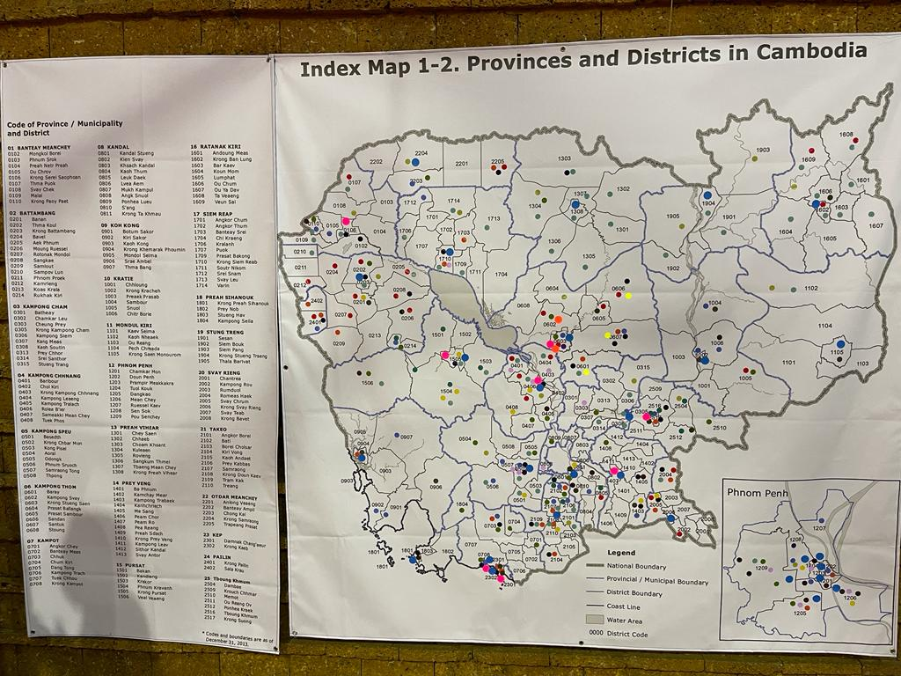
Cambodia

Slide 25
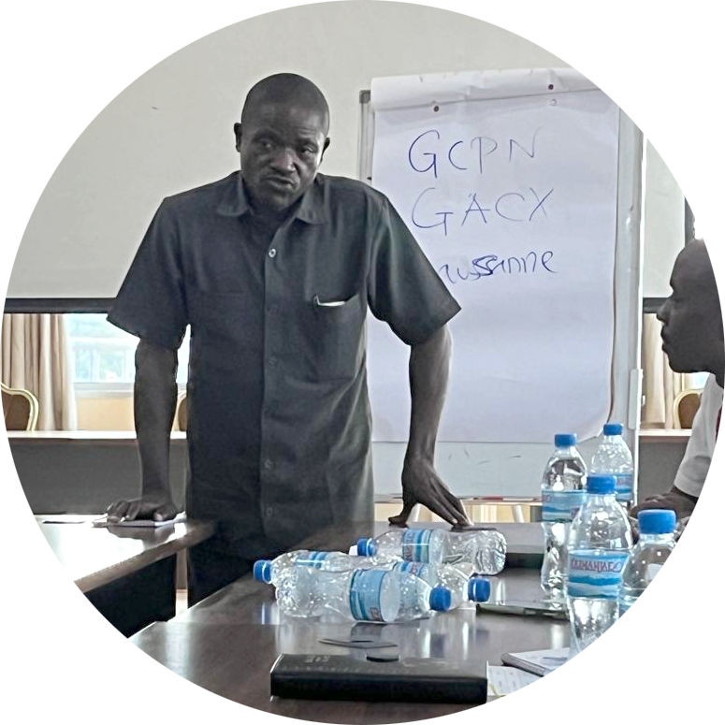
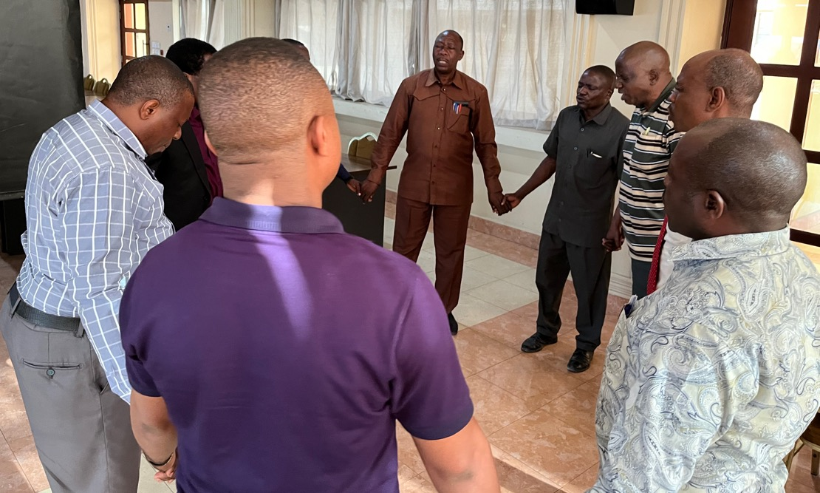
Tanzania

Slide 26
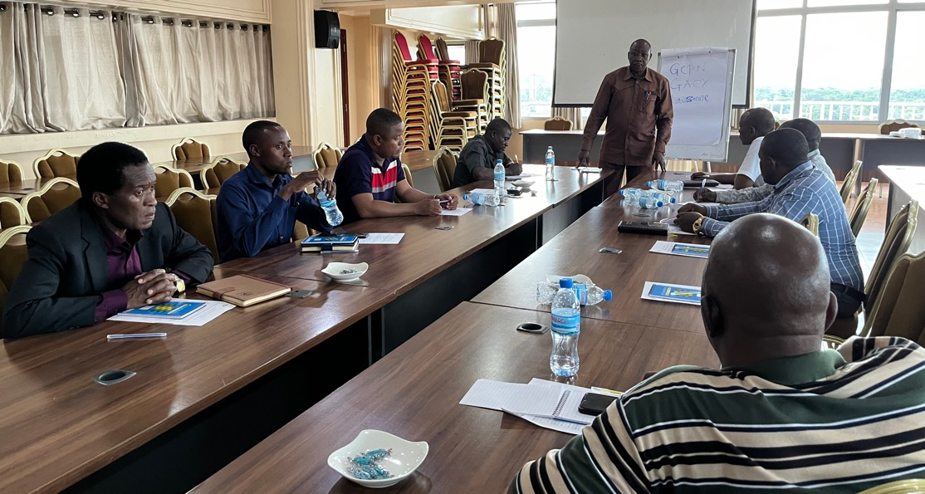
Tanzania

Slide 27

Our specific goal:
To establish an effective disciple-making,
church planting roundtable in each nation, supported by regional collaborative gatherings.

Slide 28
An invitation to collaborate to saturate the nations with disciple making churches document is available along with this PowerPoint. This one-page document provides a general agreement that can be signed by those wishing to collaborate together.
One-page
collaborative covenant

Slide 29
Collaborate to saturate invites us to work and pray for…
Progression
Namely, growing health in all four stages of collaboration
1
Leadership Team/Catalysts | Strategic Information | National Gatherings | Systems Tools/Training

Slide 30
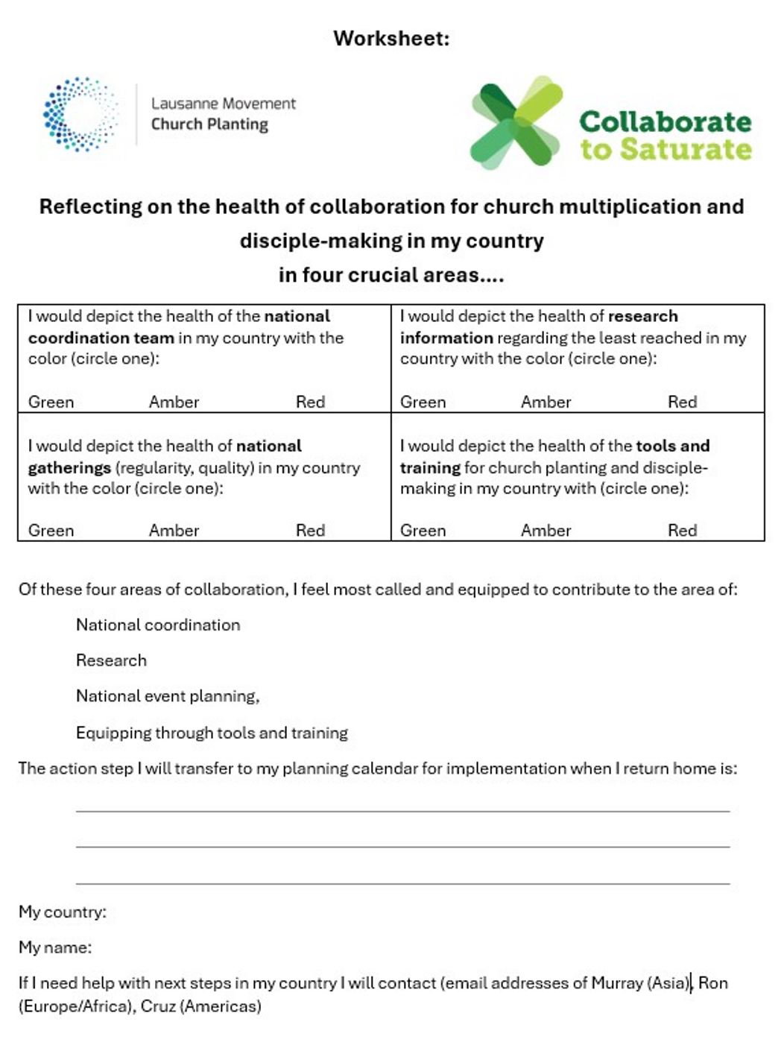
Church multiplication
and disciple-making
in my country

Slide 31
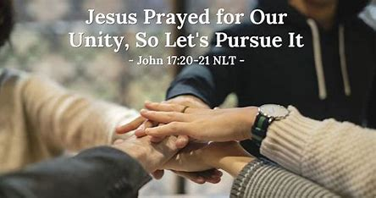
Collaborate to saturate invites us to work and pray for…
Healthy and effective collaboration in
200 nations
2
Church leaders in very nation are passionately active in collaboration for effective church multiplication “that all may know” in answer to Jesus’ prayer of John 17.

Slide 32
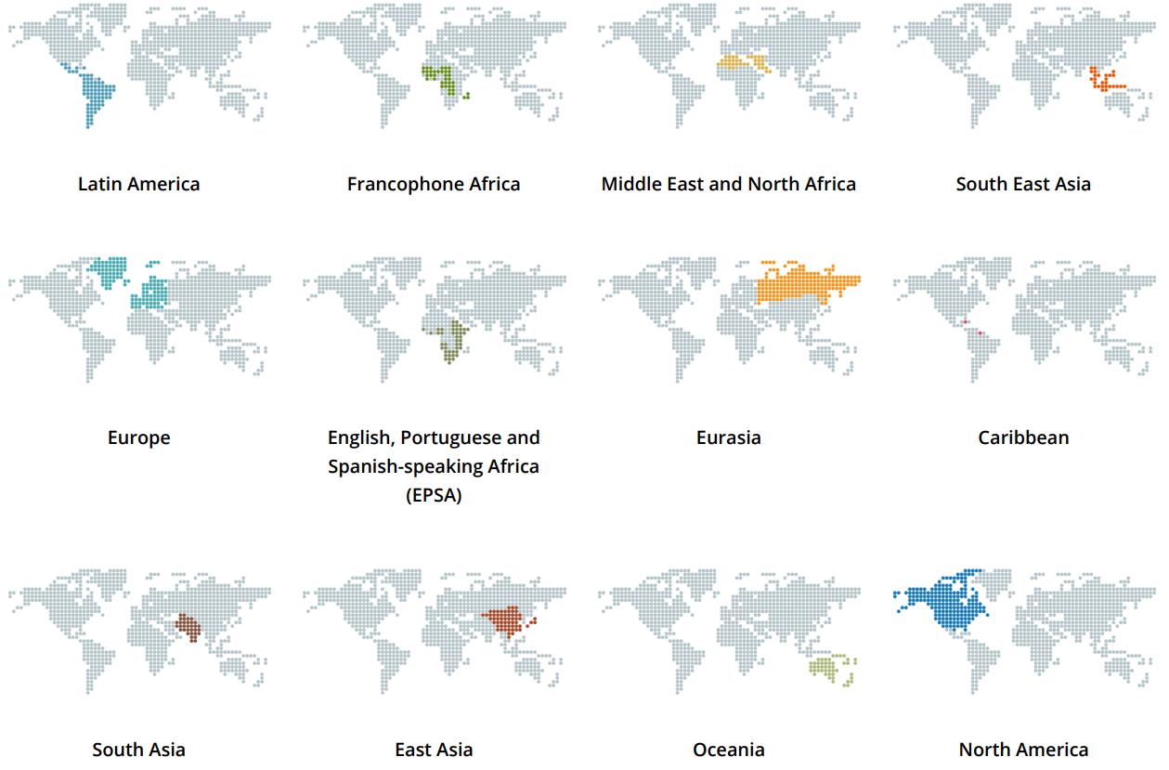
Collaborate to saturate invites us to work and pray for…
Regional support networks for shared learning and encouragement.
Next global learning community: October 29
3

Slide 33
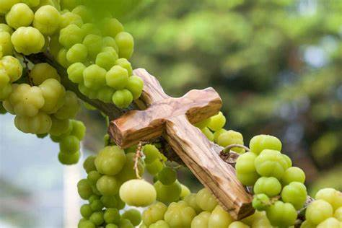
Measurement:
How will we know how we are doing?
Secure Dashboard to provide global overview for ongoing prayer and
support of national initiatives
Updated twice a year
Reflects evaluation of national leaders
To show fruit of collaboration

Slide 34
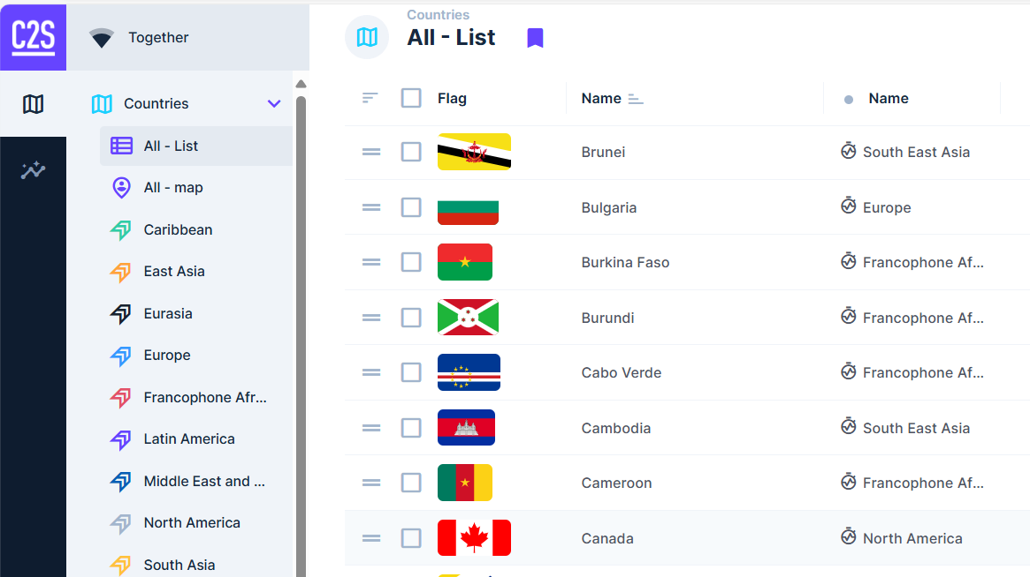

Slide 35
A gift for you!

Slide 36
Connect to this QR code to:
Receive content on a regular basis
Join us for training on October 29
Start a collaborative gathering in your country
QR ode
1
2
3

Slide 37
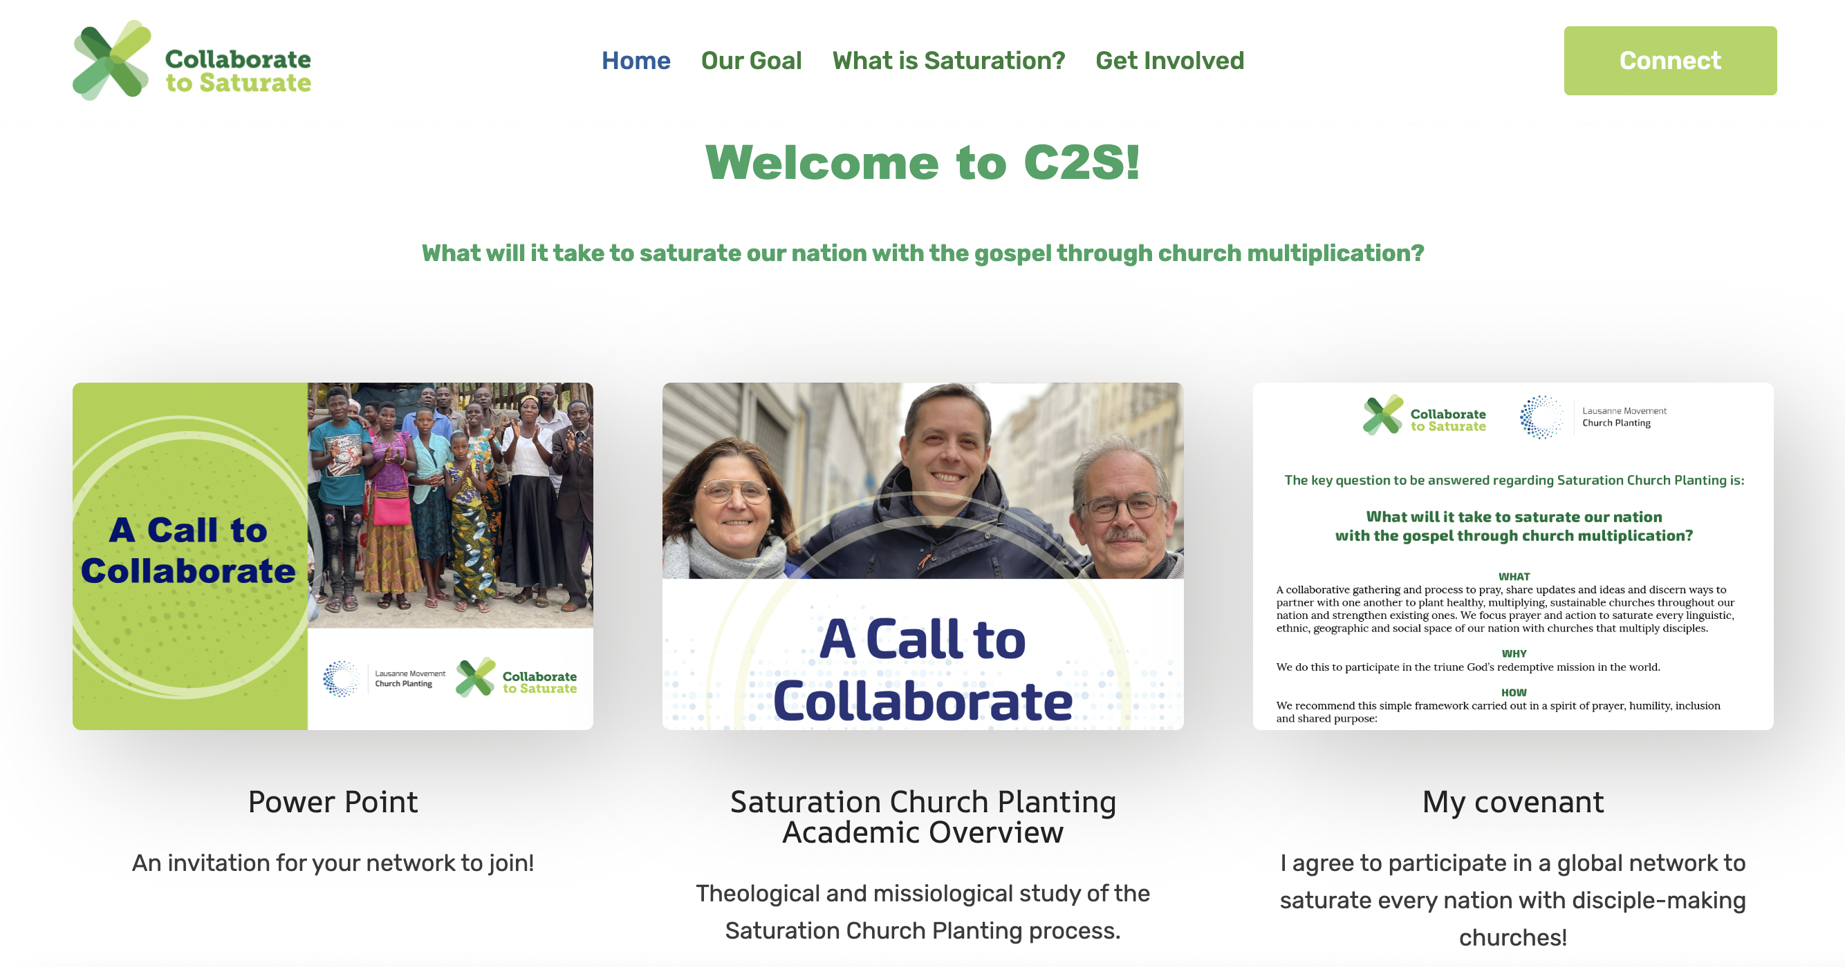

Slide 38
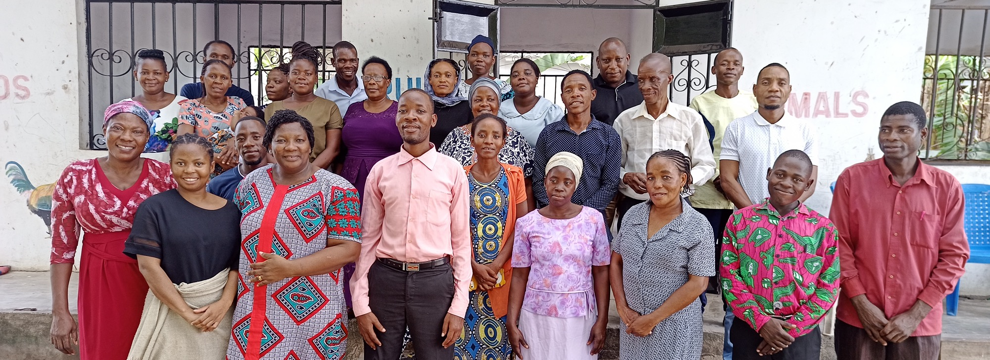

Thank you!

